Slide 1
Scene gist recognition: Amplitude or phase ?
Long Luu

Slide 2
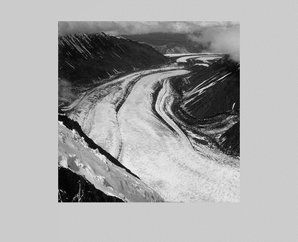
Rapid scene recognition
Human can quickly perceive scene’s properties and category
=> How is the scene represented in this task ?

Slide 3
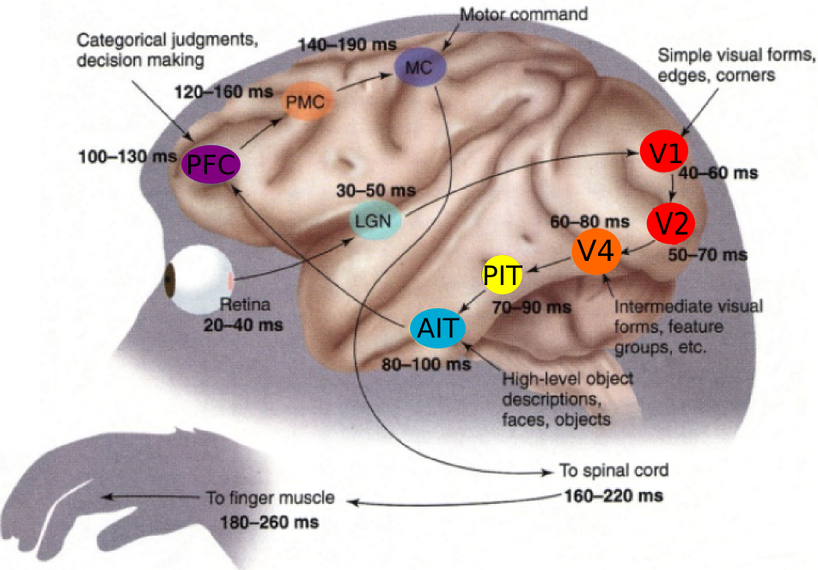
Traditional visual pathway
Scene is pooled from simpler features like objects
Thorpe & Fabre-Thorpe, 2001

Slide 4

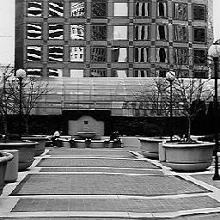
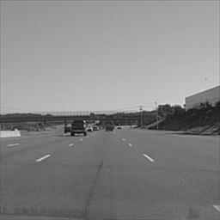

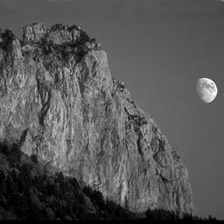
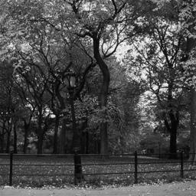
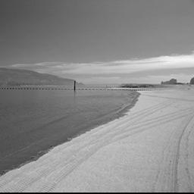

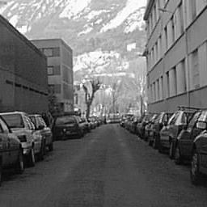

Spatial envelope theory
Scene is not just an aggregate of objects.
There exist spatial envelope properties.
Naturalness
Openness
Ruggedness
Roughness
Expansion
Oliva & Torralba 2001

Slide 5
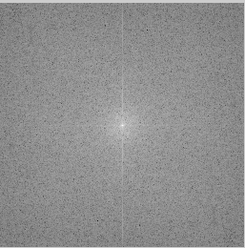
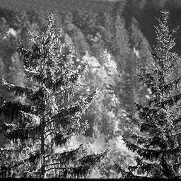
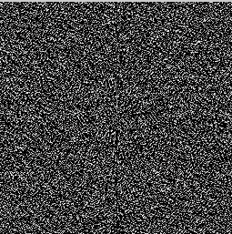
Fourier representation
Global features
Fourier transform
Amplitude
Local features
Phase

Slide 6


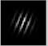

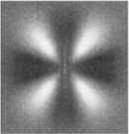
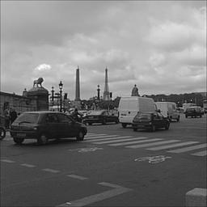
Spatial envelope model
Training:
Classification:
FFT
Gabor basis
PCA
Training images
Discriminant analysis/
Regression
Spectral templates
FFT
Correlator
Spatial envelopes
Oliva & Torralba 2001

Slide 7
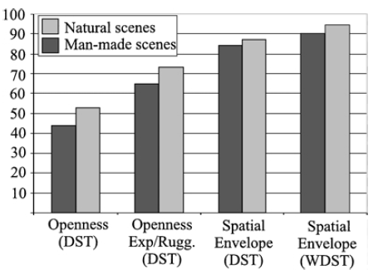
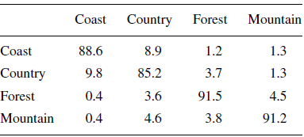
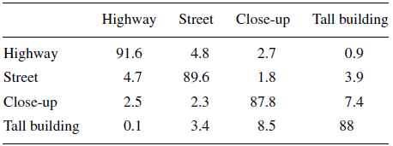
Spatial envelope model
Classification results
Oliva & Torralba 2001

Slide 8
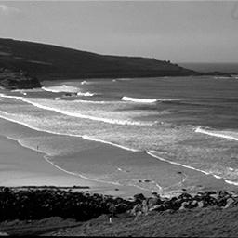
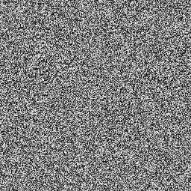

Priming paradigm
Experimental procedure:
Target image
Mask image
Prime image
20 ms
160 ms
30 ms
10 ms
Guyader et. al. 2004

Slide 9

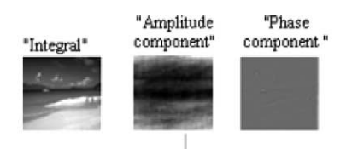
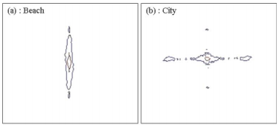
Priming paradigm
Stimuli:
Beach
City
Prime image
Target image
Guyader et. al. 2004

Slide 10
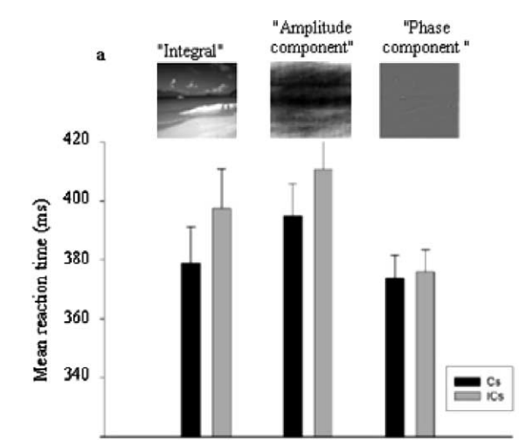

Priming paradigm
Result:
P < 0.01
Guyader et. al. 2004

Slide 11
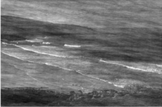
Masking paradigm
Experimental procedure:
Mask image
Target image

Slide 12
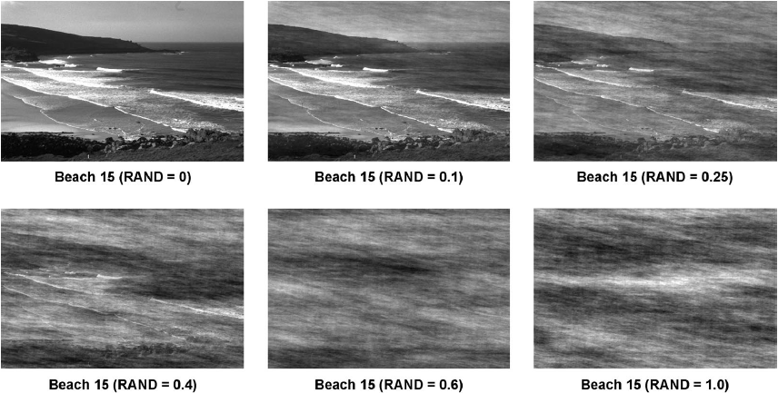
Masking paradigm
Stimuli:
5 natural (beach, river, …), 5 manmade (farm, home, …)
preserved amplitude, randomized phase
Loschky et. al. 2007

Slide 13
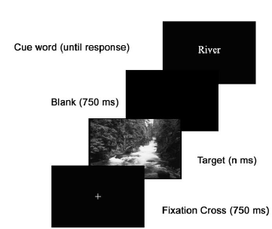
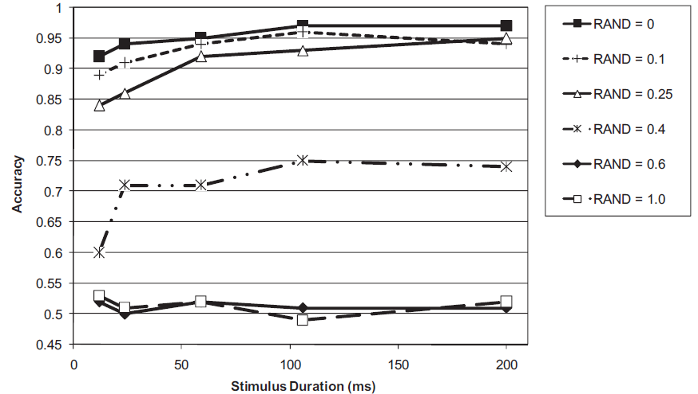
Masking paradigm
Experiment 1:
Loschky et. al. 2007

Slide 14
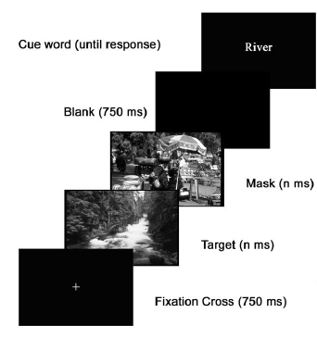
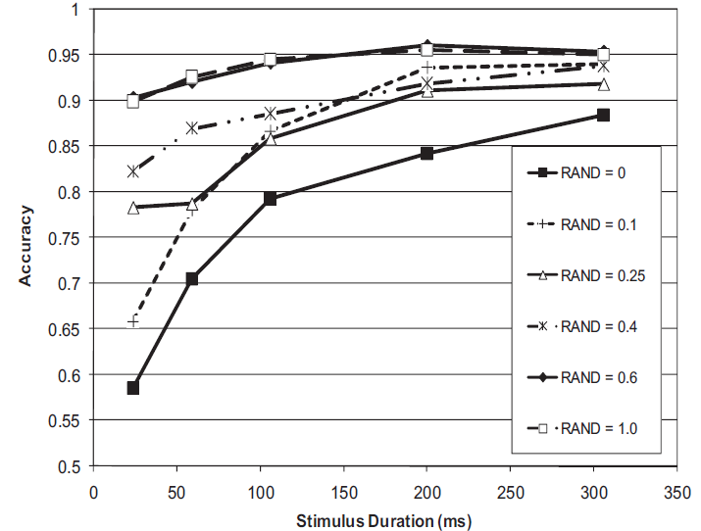
Masking paradigm
Experiment 2:
Loschky et. al. 2007

Slide 15
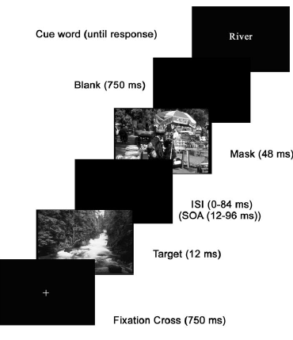
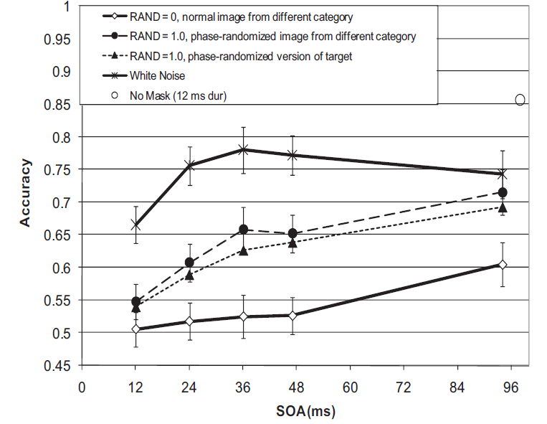
Masking paradigm
Experiment 3:
Loschky et. al. 2007

Slide 16
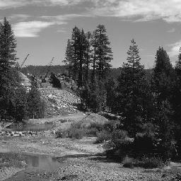
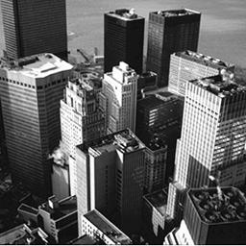
Scene morphing
Experimental procedure:
Mask image
Target image
Natural
Manmade
30 ms

Slide 17
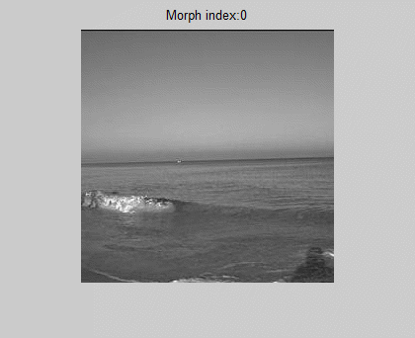
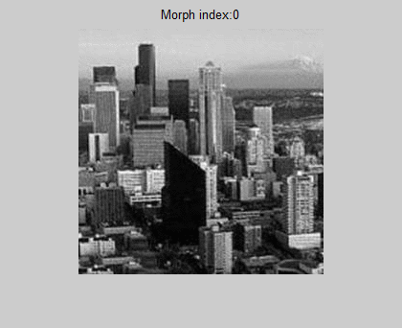
Scene morphing
Amplitude-morphed scene:
Phase preserved.
Amplitude:
Phase-morphed scene:
Amplitude preserved.
Phase:

Slide 18
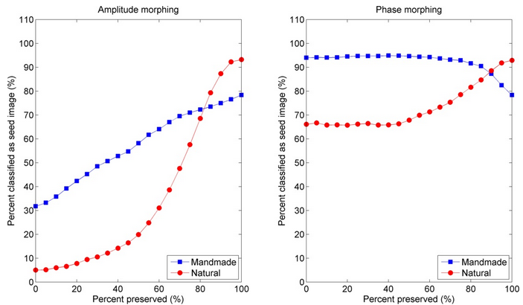
Scene morphing
Spatial envelope model result:

Slide 19
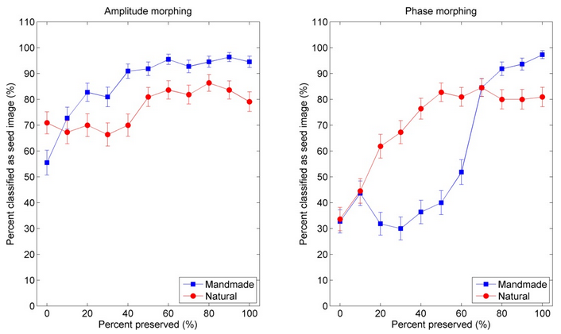
Scene morphing
Psychophysical result

Slide 20
Conclusion
Scene gist is based on both phase and amplitude information.
Phase carries more information
Need some phase-based computational model

